Slide 1
Concentration

Slide 2
By the end of this lesson you should be able to:
Explain what it means for a solution to be:
dilute,
concentrated, or
saturated.

Slide 3
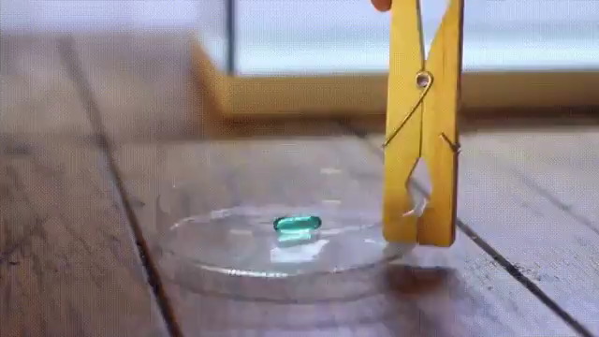
Solute vs Solvent
The substance that dissolves is called a solute. The liquid it dissolves in is called a solvent.

Slide 4

It is useful to know how much of a solute has been dissolved in a solution.
This is because solutions change their properties if the amount of solute in a solution changes.
Colour is noticeably affected, but the potency of a solution is also changed.

Slide 5
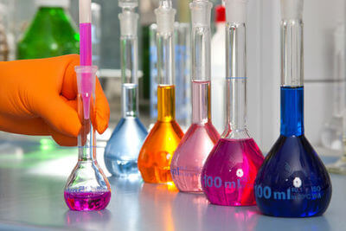
We call the measurement of dissolved solute "concentration."
Solutions with higher concentrations have less solvent or more solute.

Slide 6
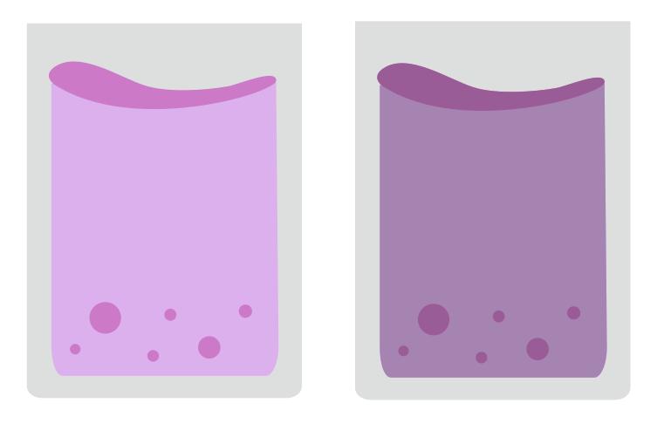
For example, say you make two cordial drinks from powder.
You have the same amount of water, 200 mL, in each glass.
You put 2 tablespoons of cordial in one glass, and 4 in the other. It dissolves to form a juice solution and there are clear differences between the two juices.

Slide 7
The juice with more cordial in it is darker, sweeter, and has more flavour.
Normally, you would say that the second cordial is "stronger" than the other, but in science we say, "more concentrated."

Slide 8
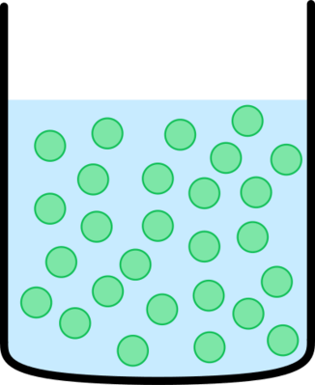
A solution can be described in terms of how concentrated it is.
A solution is highly concentrated when there are many solute particles to a given volume of solvent.

Slide 9
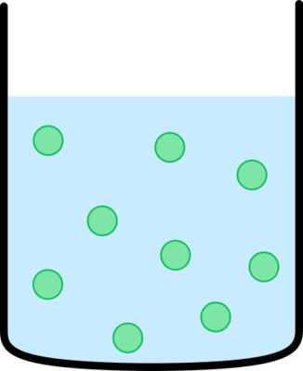
A solution is dilute if there are fewer solute particles for the same volume of solvent.

Slide 10
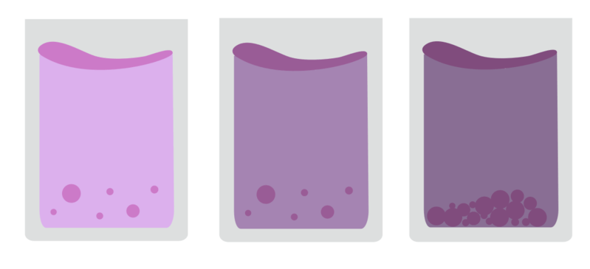
If you keep adding juice powder to a drink, eventually the powder stops dissolving into the water and forms a pile on the bottom of the glass.
When a solute will no longer dissolve into a solvent, we call the solution saturated.
This happens when the water is "full" - there is no more space in the water for solute particles to move into, so they stop dissolving.

Slide 11
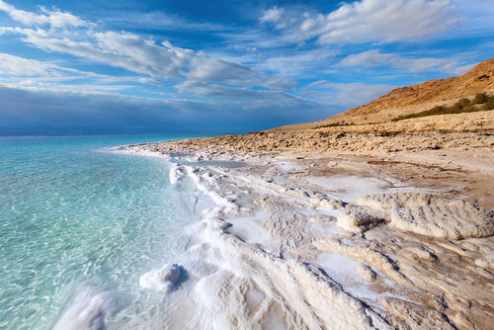
We can see saturation in nature as well.
For example, salt piles form on the sides of salty, evaporating lakes like the Dead Sea.
Water is being removed, making the lake more concentrated, until the lake becomes saturated with salt.
The solution is full of salt that salt is pushed out in the form of salt piles on the shore.

